Slide 1
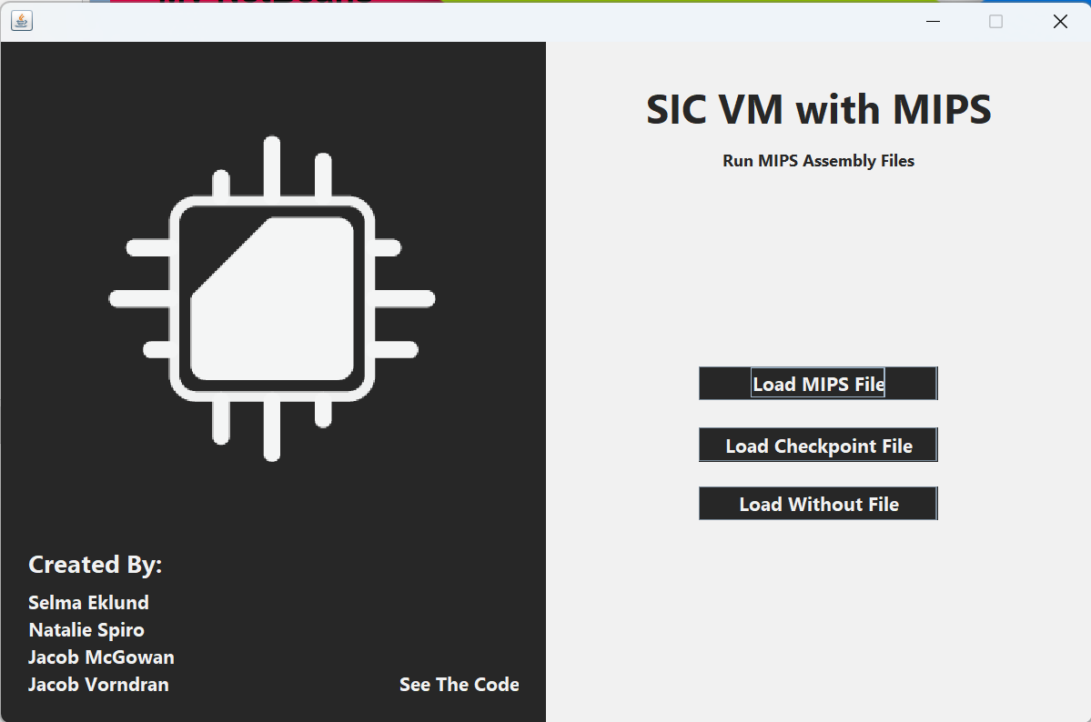
SIC-VM Project Prototype
Team - Core Computing Solutions
Project Update
What We Have
What We Need
Challenges
Selma Eklund
Natalie Spiro
Jacob McGowan
Jacob Vorndran

Slide 2
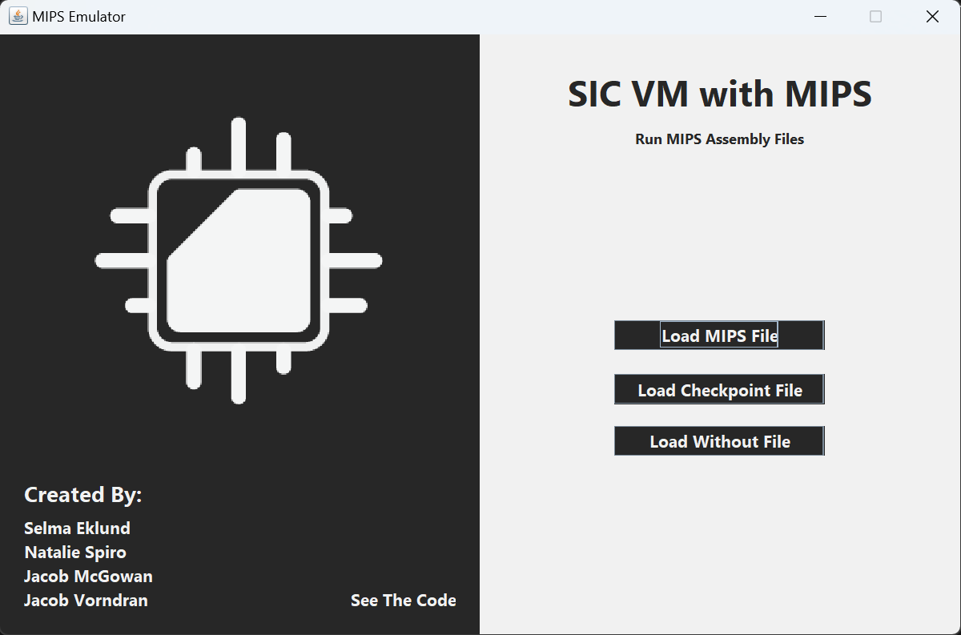
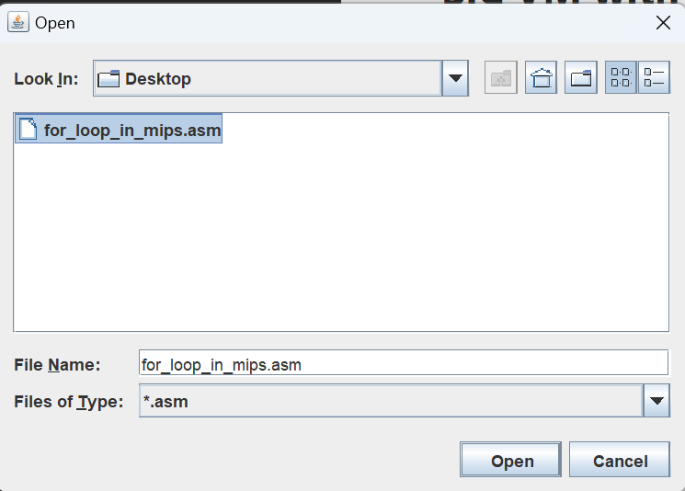
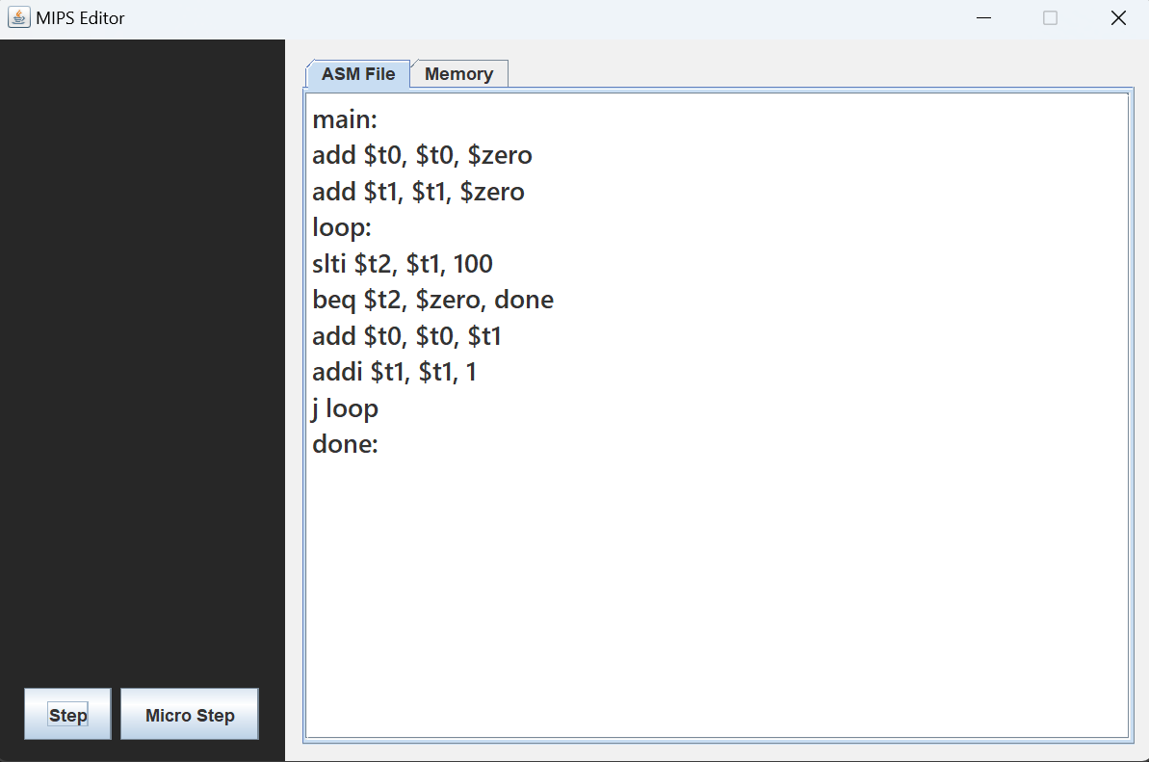
What We Have
Load a .asm / .obj file and split it into each line and process what it is doing.
UI Base
Show code
Show memory
Show registers
Show steps being done
Buttons

Slide 3
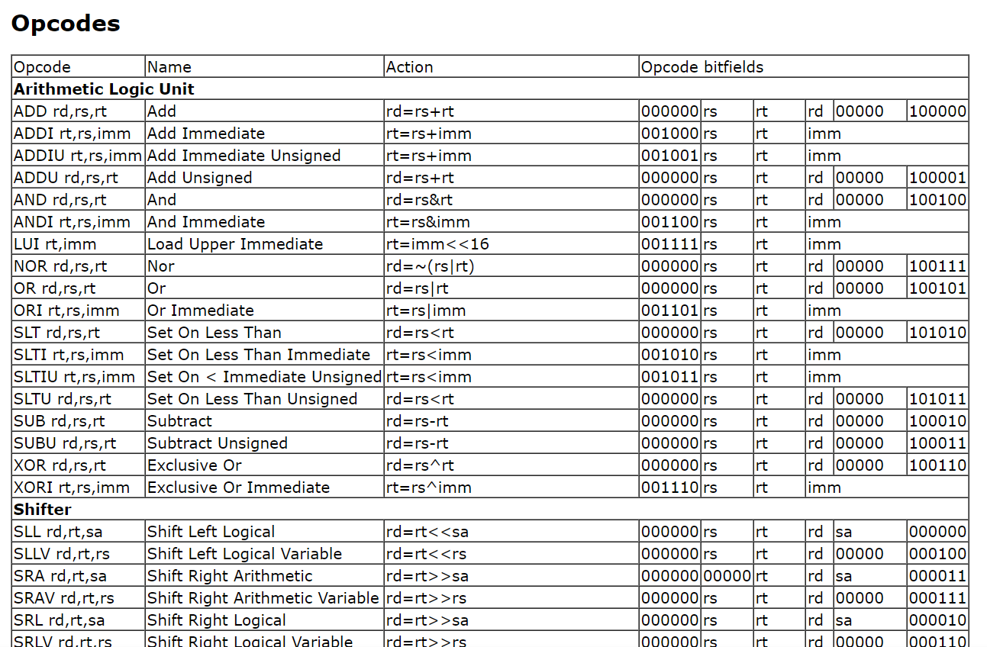
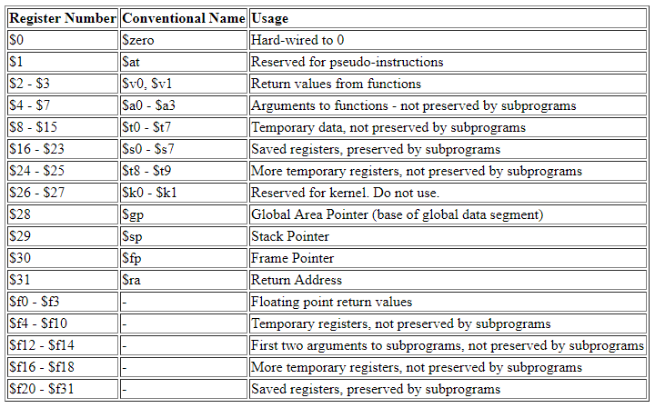

What We Need - Tasks
Natalie - Create the functions for each of the commands in mips
Jacob - Create a way for the program to step through commands w/ microsteps and steps
Jake - binary / hex readout for memory and registers, how the data is stored and changed
Selma - a way to save and load a checkpoint file, how the data is used in program.

Slide 4
Challenges
Solutions
Group meetings - finding days that line up, but when we do, we get things done
Work at the same time - certain task need to be done before others causing workflow problems, nothing crazy, but noticeable
Sense of urgency
Meet online - finding days that line up, but when we do, we get things done
Redistribute tasks - chop tasks into smaller segments with small deadlines so others can expect things at certain times
Add check in dates with checks on our expectations - change the plan if it is not working well, or work together on challenging parts of the code.

